Slide 1


INDIAN CITIES DASHBOARD
20ADC22 – DATA ANALYSIS
Submitted by
VIJAYAKUMARAN S (21ADR061)
ROHITH S J (21ADR040)
VIBEESH N (21ADR059)
RISHI RAGHAV G (21ADR038)
VIGNESH T (21ADR060)
Department of AI
Kongu Engineering College, Perundurai

Slide 2
Problem Statement
There are many cities in India, so there will be many Data’s to store(for example total population ,male population , female population , literature, male-literacy-rate, female-literacy-rate , child-sex-ratio , sex-ratio , tax , language spoken etc..,). On the view this whole data there will be more rows(which is independent of priority) so it will be difficult to view top values in data.
Sex ratio is higher in many cities for example Bhiwandi sex ratio is 700 so there 700 women’s for every 1000 men. It is major problems now a days the men population is dominant than female population. This will lose of many job opportunities for one gender in the cities.
In top cities population is major problem it leads to crowding, pollution etc.. for example Delhi is the second most populated in India it has 75% of air polluted because of over population and usage of many vehicle. It also an emerging problem in many leading cities.

Slide 3
Introduction
This project is to solve the analysis of those data and to easily get insights. Here analysis made on the cities of India and then a dashboard is created.
Large human settlements include cities. For housing, transportation, sanitation, utilities, land use, commodity production, and communications, cities typically have vast systems.
More effective service and product delivery are happens in cities.
A tax is a mandatory financial charge or other sort of levy that is levied on a taxpayer by an institution of government to pay for government expenses and other public expenditures.
So tax analysis on each city is also done in this project.
This Dashboard gives an overall analysis of an City which will be useful to some Business Objectives in which they need data like analysing the City population, Tax, graduates, literates etc.,

Slide 4
Business Objective
To visualize the data using dashboard so the data of top cities can be viewed. The dashboard is used for education of cities in school, college etc.
To analyze the better performing cities based on educational and other fields.
To analyze of graduates in cities which will helps for big companies to make their branch office in that particular city.
To Analyze the population of cities, which is used to predict the resources needed for the particular city or location.

Slide 5
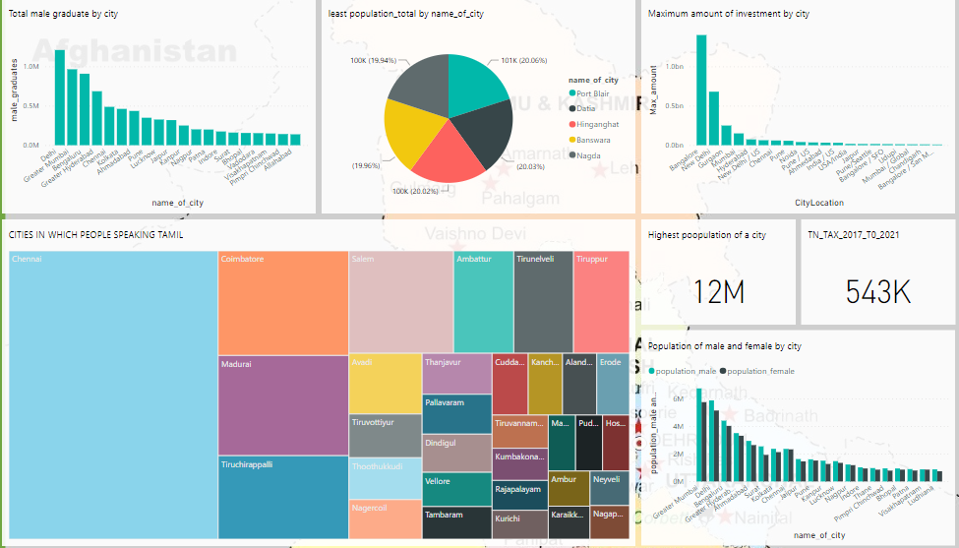
Dashboard

Slide 6
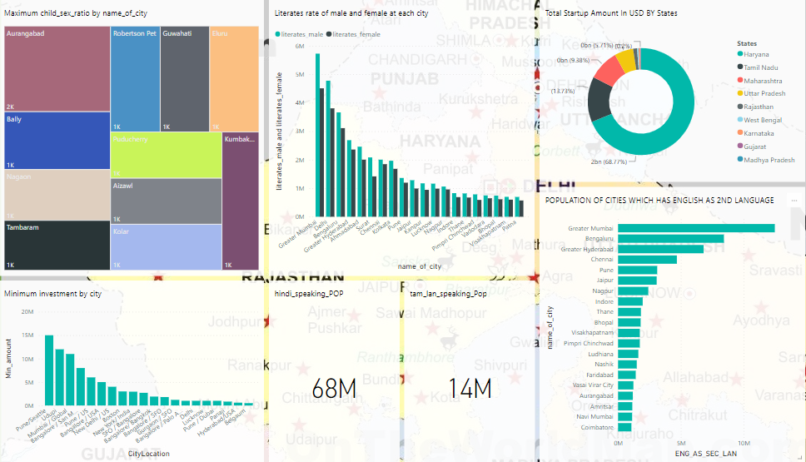
Dashboard

Slide 7
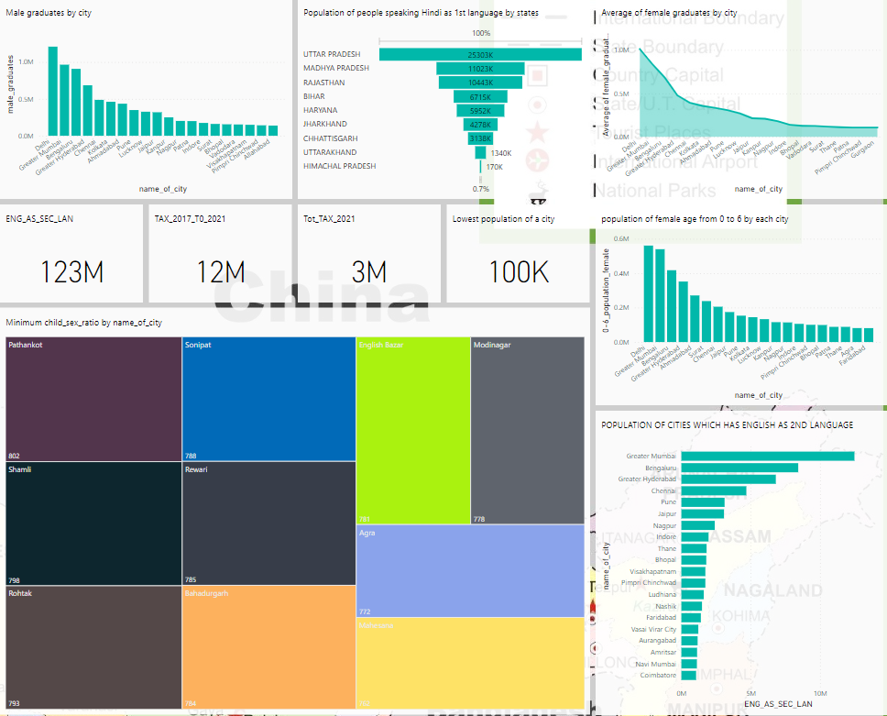
Dashboard

Slide 8
Inference
The Delhi city has the most male graduates around 1210040 and Mumbai has 964964 it is in second position.
Port blair , Datia , Hinganghat, Banswara and Nagda are the least populated cities in India which has population less than 100k.
Mumbai has around 6736815 males and 5741632 female population and it is followed by Delhi which has 5871362 males and 5136473 female population.
Literacy of both male and women in each cities, in that Mumbai has the highest no of literacy rate in that 5727774 are males and 4509812 are female.
Bangalore has the largest amount around 1.4bn invested in its start up companies.
Pune has the least amount 15million invested in its start up companies.
Mumbai has around 13 million people who speak English as the second language.
All the state has paid tax form 2017 to 2021 is 12 million ,in that Tamil Nadu has paid 543K tax amount form 2017 to 2021

Slide 9
Conclusion
The indian cities analysis has been done using Power Bi tool and various insights are performed and visualised. It can identify the least and highest population in cities and it can be used for business objective. The analysis of population will helps in many ways like how many buses are needed for public transportation?, how much food supplement are need when in flood or cyclone period.
The analysis of graduates in cities will helps for big companies to make their branch office. The visualization of Indian cities in power bi charts will helpful for teaching or education purpose, because it is more effective by studying in diagram than of theory. And it will be helpful for children the can easily remember like which city has most population or which city has least population? Etc..,
It will be helpful for many foreign countries to make their business in cities, like if it is a school they more population and if it a chemical factory they need less population.

Slide 10
References
[1] Anuj Tiwari and Dr. Kamal Jain, “GIS Steering Smart Future for Smart Indian Cities.” International Journal of Scientific and Research Publications, Volume 4, Issue 8, August 2014.
[2] Sejal S. Bhagat, Palak S. Shah and Manoj L. Patel, “Smart cities in context to Urban Development.” International Journal of Civil, Structural, Environmental and Infrastructure Engineering Research and Development, Volume 4, Issue 1, February 2014, 41-48.
[3] Charbel Aoun, “The Smart city Cornerstone: Urban Efficiency.”Schneider Electric White Paper, 2013.
[4] R. R. Widner, “Physical Renewal of the Industrial City,” Annals of the American Academy of Political and Social Science, vol. 488, pp. 47–57, Nov. 1986.
[5] Wikipedia contributors, “Adaptive reuse,” Wikipedia, the free encyclopedia. Wikimedia Foundation,Inc., 21-May-2012.
[6] Ellie Cosgrave and Theo Tryfonas, “Exploring the Relationship between Smart City Policy and Implementation.”The First International Conference on Smart Systems, Devices and Technologies, 2012.”

